Slide 1
Working with data using Python libraries
NumPy and Pandas

Slide 2
Agenda
Introduction to NumPy and Pandas
Features of NumPy
How NumPy array is faster than Python list
NumPy array and Functions to create NumPy arrays
Common methods in NumPy
Indexing and Slicing of an array
Broadcasting in NumPy
Pandas capabilities
Pandas Series and ways to create a Series
Pandas DataFrame and ways to create a DataFrame
DataFrame methods
Pandas Indexing
Pandas Pivot tables
Summary
Hands on

Slide 3
Introduction to Numpy and Pandas
NumPy – numerical python
Handling multi-dimensional arrays.
It is inspired from MATLAB and provides similar functionalities.
Many latest libraries like TensorFlow are inspired by its design.
Most of the code is compiled using C, so it faster than a Python loop.
Pandas
Handling arrays & data frames.
It is built on top of NumPy.
It is widely used for data manipulation and data analysis.
It supports variety of functions and operations for cleaning and manipulating the data.

Slide 4
Features of NumPy
Linear algebra
Arithmetic operations
High Performance
NumPy
Broadcasting
Statistical
operations
Inbuilt Functions
Occupies minimal memory
Random module
Notes:
Diagram created internally

Slide 5
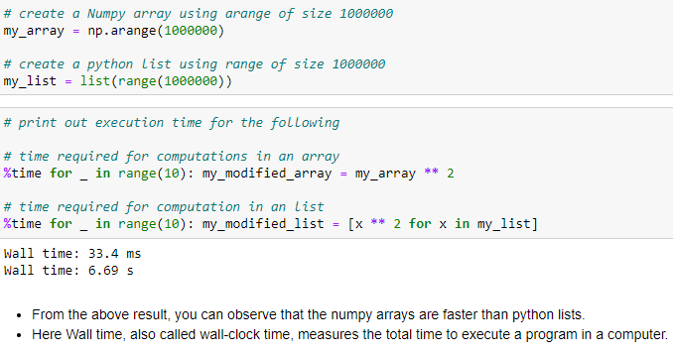
How Numpy array is Faster than Python list?
Numpy can divide a task into multiple subtasks and perform them parallely, and functions in numpy are implemented in C. Hence numpy is faster compared to python lists.
Arrays occupy less memory, works faster and are convenient to use
Notes:
Diagram created internally

Slide 6
Numpy array and Functions to create arrays
Numpy array:
Core data structure of NumPy.
Stores values of the same type i.e. homogeneous in nature.
Values are stored at one continuous location in memory hence memory efficient.
Functions to create arrays:
array( ) function can be used to create multi dimensional arrays using lists or tuples.
arange(): To create 1-d arrays with incremental values.
linspace(): To create a array of evenly spaced numbers over a specified interval.
And many more…
Notes:
Diagram created internally

Slide 7
Common Methods and Functions
To understand the shape and size:
ndim: is used to check the dimension of the array.
shape: is used to check the shape of the array.
size: is used to check the count of elements in an array
reshape: is used to give a new specified shape to an array without changing the data.
Checking and changing data types:
dtypes: is used to check the datatype of an array.
astype: is used to change the datatype of an array into specified datatype.
And many more….
Notes:
Diagram created internally

Slide 8
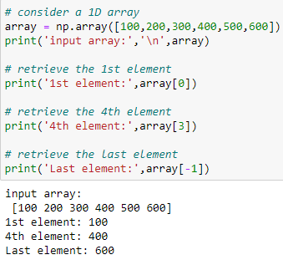
Indexing of an Array: Index 1D array
Each element in the array can be accessed by passing the positional index of the element. The index for an array starts at 0 from left. It starts at -1 from the right
Second element at 1st index
(+) Index: 0 1 2 3 4 5
100 | 200 | 300 | 400 | 500 | 600
(-) Index: -6 -5 -4 -3 -2 -1
Array length is 6
Notes:
Diagram created internally

Slide 9
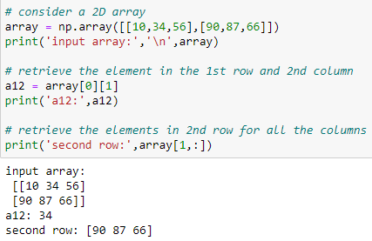
Indexing of an Array: Index 2D array
Element in 2D array can be accessed by the row and column indices. We can also select a specific row or column by passing the respective index.
Column index
0 1 2
0
34 | 78 | 98
45 | 76 | 88
Element in 1st row 2nd column
Row index
1
Notes:
Diagram created internally

Slide 10
Slicing of an array: Slice arrays
Expression
Shape
Output
10 | 20 | 30
40 | 50 | 60
70 | 80 | 90
([[40,50],
[70,80]])
array[1:, :2]
(2,2)
10 | 20 | 30
40 | 50 | 60
70 | 80 | 90
array[1]
(1,3)
([40,50,60])
array[1:2, :]
10 | 20 | 30
40 | 50 | 60
70 | 80 | 90
array[0, 1:]
array[0:1, 1:]
(1,2)
([20,30])
Notes:
Diagram created internally

Slide 11
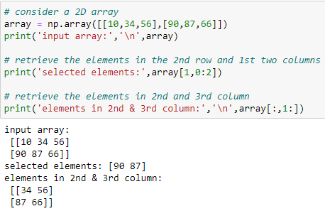
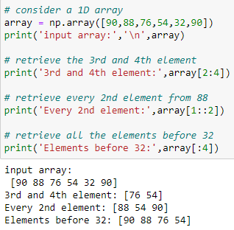
Slice 1D array and 2D array
Indexing allows us to extract a single element from the array, while, slicing can be used to access more than one element.
Slicing can be used to return a sub-matrix of the original array.
Notes:
Diagram created internally

Slide 12
Broadcasting in NumPy
It is the ability of NumPy to treat arrays of different shapes during arithmetic operations. Arithmetic operations on arrays are usually done element-to-element wise. If two arrays are of exactly the same shape, then these operations are performed smoothly.
If the dimensions of two arrays are dissimilar, element-to-element wise operations are not possible. However operations on arrays of dissimilar shapes is still possible in NumPy, because of the broadcasting capability. The smaller array is broadcast to the size of the larger array so that they have compatible shapes.
x(3,2)
y(2)
z(3,2)
1 | 10
2 | 20
3 | 30
200 | 400
200 | 400
200 | 400
201 | 410
201 | 420
203 | 430
+
=
Notes:
Diagram created internally + screenshot taken from the personal notebook

Slide 13
Pandas capabilities
Handling various forms of data
Reshaping datasets
Manipulating the data
Pandas
Handling missing data
Join, merge, and concat
Grouping and filtering data
Splitting and modifying datasets
Pandas Profiling
Notes:
Diagram created internally

Slide 14
Pandas Series and Ways to create Series
Series is one dimensional array which can hold any data type
It can hold any data type, e.g. integers, floats, strings, etc
In Series the index numbers are automatically generated corresponding to the values of the series, index number starts from 0 and so on….
Ways to create series:
Can create a empty Series using the syntax pd.Series()
A pandas series can be created from a python list, dictionary, or numpy array.
Notes:
Diagram created internally

Slide 15
Pandas DataFrame and Ways to create DataFrame
It is 2 Dimensional tabular data structure
It is Similar to SQL table or an excel sheet
It is most widely used Pandas data structure
Like Series, input can be anything (ndarray, dictionary, list, series, etc.).
pd.DataFrame() is used to create a dataframe.
Ways to create DataFrame:
Can create a empty DataFrame using the syntax pd.DataFrame()
DataFrames can be created from dictionary, the keys will be the column names and values will be the values of those columns.
Also, Dataframes can be created from arrays, can give the names of the columns using the columns parameter.
Notes:
Diagram created internally

Slide 16
DataFrame methods
To check shape, size and understand the data frame
shape - to check the no. of rows and columns in a dataset
info(): used to check the basic information about the data frame such as column names, count of non null values and datatypes of the columns etc.
To perform statistical analysis of features
describe() - used to get the statistical summary
To check the unique values, count of unique values of the columns
nunique(): used to fetch ‘count’ of unique values of the columns
unique(): used to fetch the unique values of the columns
Notes:
Diagram created internally

Slide 17
DataFrame methods
To perform data manipulation:
apply() - can be used to run a particular function across multiple rows.
rename() - to rename the columns of a dataframe.
isnull() - to identify the presence of missing values in the dataset.
dropna() - to drop missing values from a dataset.
Groupby in Pandas:
Groupby involves two steps:
step1: Splits and groups the data based on the specified category.
step2: Can apply various aggregation functions such as sum(), count(), mean() etc. on a specified column.
Notes:
Diagram created internally

Slide 18
Pandas indexing
Pandas provides methods for accessing specific views or sections of a dataframe.
Indexing helps to access any instance from a dataframe or a series.
Both rows and columns have index, row indices are specified by row index value. or index names and for columns its column index number or column names.
Most commonly used indexing methods are .loc[ ] and .iloc[ ]
Notes:
Screenshot is taken from a personal notebook

Slide 19
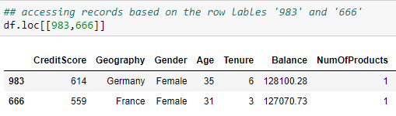
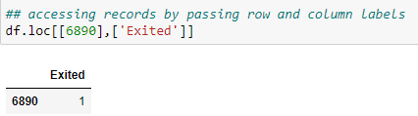
Pandas indexing
.loc[ ] uses label to select data
Helps to access group of rows and columns based on the labels.
In .loc method in order to access the required instances we need to pass the name of the rows and columns.
Notes:
Screenshot is taken from a personal notebook

Slide 20
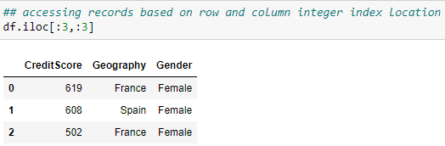
Pandas indexing
.iloc[ ] uses position (integer location) to select data.
Helps to access group of rows and columns based on the integer index location
In .iloc method in order to access the required instances we need to pass the integer index value of the rows and columns
Notes:
Screenshot is taken from a personal notebook

Slide 21
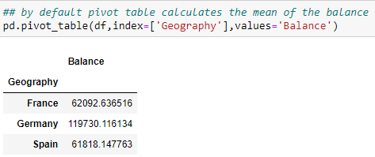
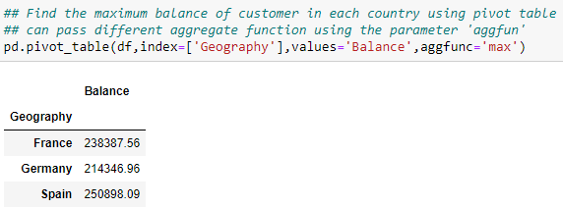
Pivot Tables
It has a Data Frame like structure
It is used to display the data for the specified columns and index
The pivot_table() method generates a pivot table for the given index
By default, the aggregate function is ‘mean’, which aggregates the columns passed in the parameter, ‘values’
Notes:
Diagram created internally

Slide 22
Hands on
Notes:
Diagram created internally

Slide 23
Thank you Happy learning ☺

